Slide 1


FabLab Online Community
A Digital Inclusive Open Community
that democratizes the power of digital fabrication
With
Shared Purposes
Shared Values
Shared Connections

Slide 2
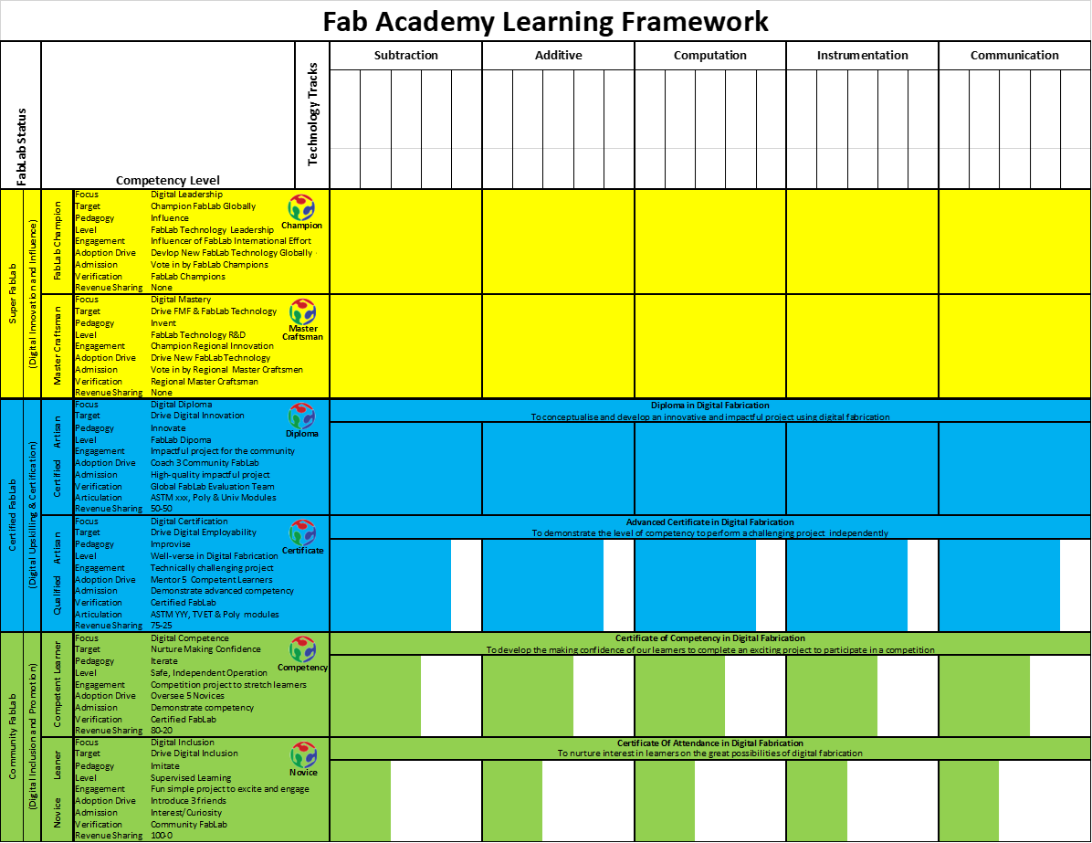
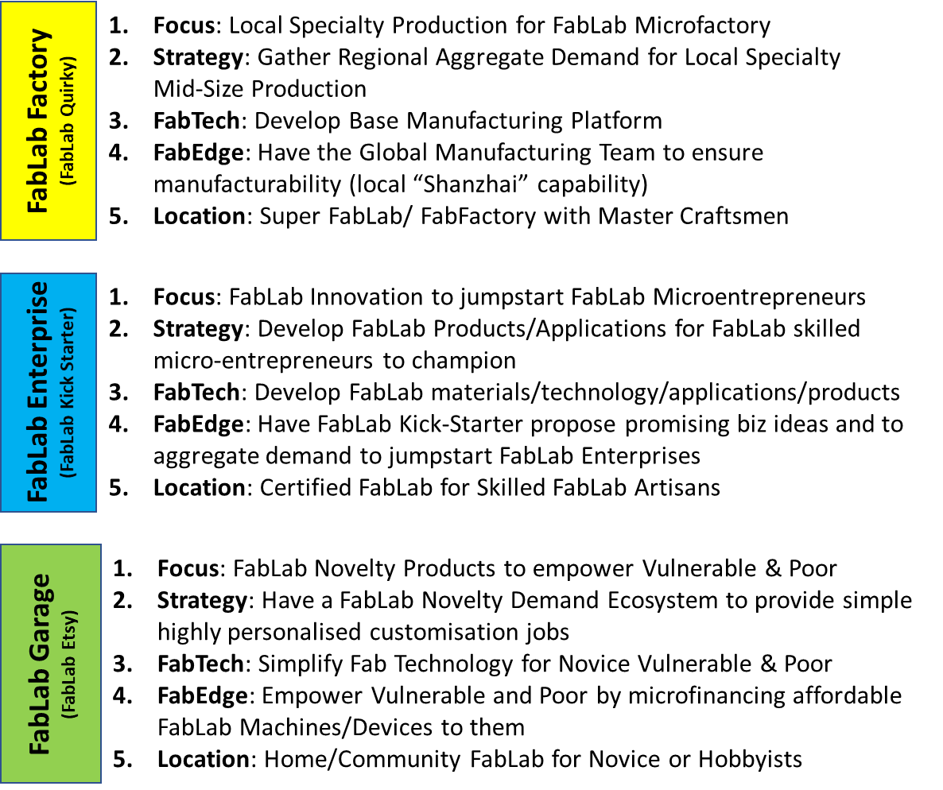
FabLab Challenge Framework
FabAcademy Learning Framework
17 UNSDG
Challenges
FabCity
Challenges
FabLab Marketplace Framework
Challenge
Contexts
Challenge
Contexts
User
Comm
User
Comm
User
Comm
User
Comm
Artisan
Talents
Demand
Aggregation
Challenge
Contexts
Challenge
Solutions
Tech
Comm
Tech
Comm
Tech
Comm
Tech
Comm
Application
Context
Products &
Applications
17 UNSDG
Application
Focus
FabCity
Application
Focus
Technology
Enablers
Artisan
Talents
Training
Packets &
Curriculum
Engaging
Projects
Technology
Enablers
Challenge
Contexts
Challenge
Solutions
Novelty
Handicrafts
Products &
Solutions
Manuf’g
Platform
FabLabs.io Platform
Creative Commons Platform

Slide 3
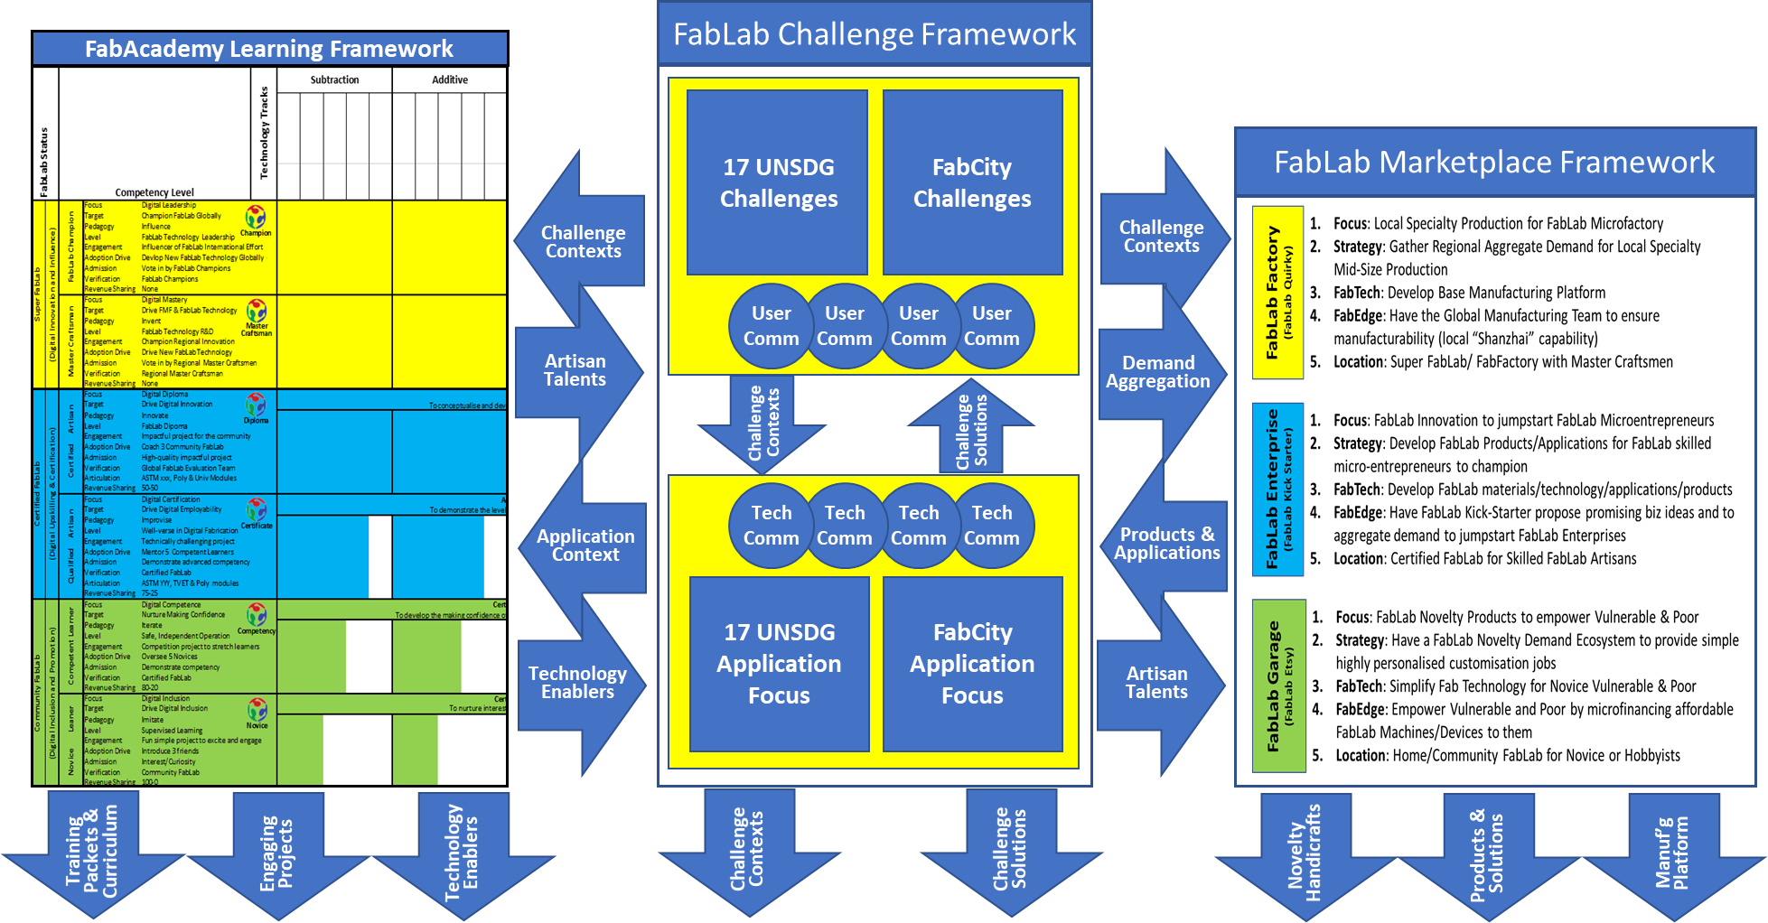
FabLab Social Engagement Framework
FabLabs.io Social Engagement Platform
As Participants
FabExplore
FabEngage
FabLearn
FabCertify
FabEmploy
As Contributors
FabConnect
FabChallenge
FabAdvocate
FabEnterprise
FabCoach

Slide 4
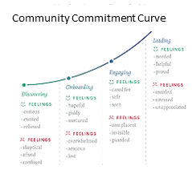
FabLab Online Community Journey
A Digital Inclusive Open Community
that democratizes the power of digital fabrication
Key Influencers & Advocacies
Key Influencers and Advocates?
Key Advocacies?
Call-to-Action (CTA to MaD)?
Advocacy Seeding (5Ws)?
Content Seeding?
Technology Seeding?
Critical Mass
Value & Purpose
Shared Values?
Shared Identities?
Shared Concerns?
Shared Purpose?
Community Types?
Elders?
Gatekeepers of Safe Spaces?
Members and Personas
Who are we serving?
Diverse Types of Members?
Different Personas? Personalized?
Shared Connections/Belonging?
Shared Voice?
Shared Experiences?
Shared Safe Spaces?
Campfires?
Community Engagement
Inception
Community Commitment Curve?
Content Navigation Structure?
Community Segmentation?
Regionalization?
Auto-tagging & Related Topics?
Automation Tools?
Community Analytics & Metrics?

